Slide 1

TOOL VAULT 2.0
UST’S Reusable Asset Library Leveraging Contest
14th March 2018

Slide 2
Introduction
TFS Reporting Utility
This application will be connecting to TFS (Team Foundation Server) and fetch product backlog items and generate detailed report of user stories for a given sprint along with description, status, assignee, velocity/effort, change sets, test cases etc. and show overall summary and this report will be sending to configured users.

Slide 3
Design and Features
TFS Reporting Utility is a windows application built in .NET 4.5. The core part is to connect to TFS and fetch information using the .NET assembly Microsoft.TeamFoundation.
Features
Create details sprint report in HTML format.
Each user stories and child work items.
Display status of each task.
Check-in details.
All items will be linked to TFS so user can navigate to respective pages of TFS.
Customized reporting.
Output format can be extended to XML, Excel, PDF etc.
Report will be sending via email to configured users.

Slide 4
Why we have a separate tool if TFS Urban Turtle
TFS urban turtle is too complex for users.
Difficult to configure for generating customized report in urban turtle.

Slide 5
Configuration
Application can be pre-configured with project and team information.
<appSettings>
<add key="TFSLocation" value=“<TFS URL>" />
<add key="ReportFileName" value="TFSProjectReport.html" />
<add key="ProjectName" value=“<ProjectName>" />
<add key="SMTPServer" value=""/>
<add key="MailFrom" value=""/>
<!-- {0}=>Project, {1}=>Sprint -->
<add key="MailSubject" value="TFS Project Report - {0} {1}"/>
<!-- {0}=>Project, {1}=>Sprint -->
<add key="MailBody" value="Please find attached TFS Project Report &#13;&#10;Project: {0} &#13;&#10;Sprint: {1}"/>
<add key="DefaultEmailAddresses" value=“Firos.Shamsudeen@ust-global.com;Vishnu.Vimala@ust-global.com"/>
</appSettings>

Slide 6
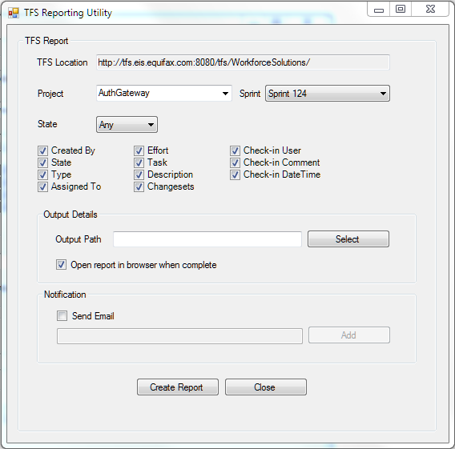

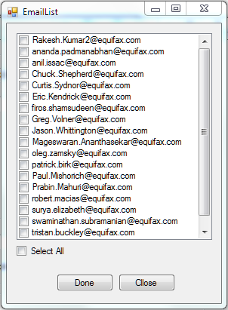
Screenshots
Different states
Configured emails to send report

Slide 7
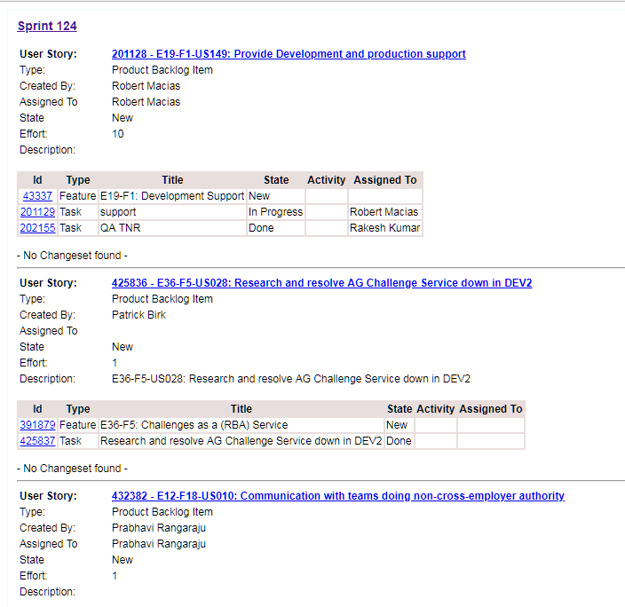
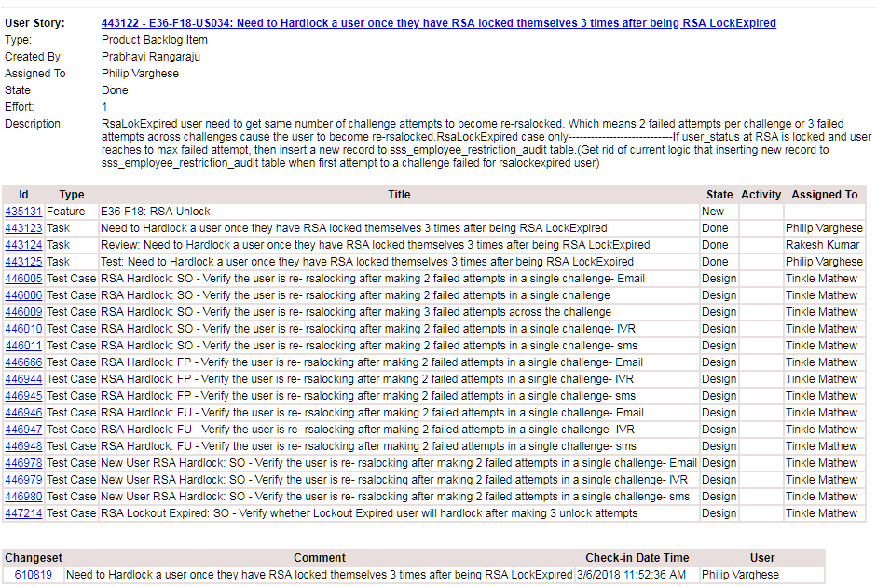
Report template

Slide 8
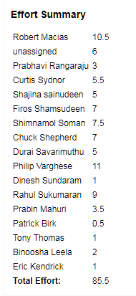
Overall Summary

Slide 9
Reusability
This tool can be used for any team who are working in Agile using TFS.
Even though this is a windows application, the design logic can be reused for making a web application or web/windows service.
The report template is plain html and the design can be changed easily asper the requirements.

Slide 10
About the Team
Vishnu Vimala
Work for Equifax for last 2 years. .NET/UI developer
Firos Shamsudeen
Work for Equifax for last 5 years. .NET/UI developer

